Slide 1
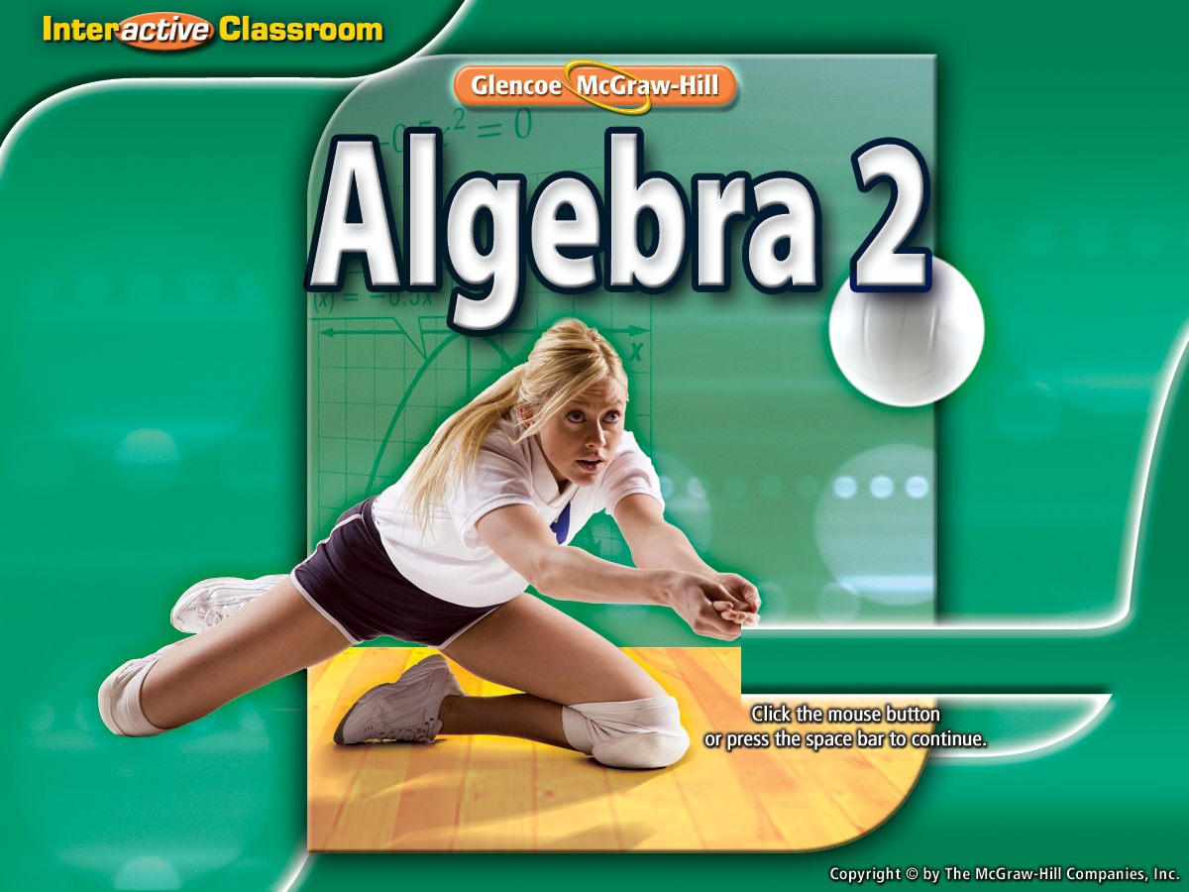


Splash Screen

Slide 2
Lesson Menu
Then/Now
New Vocabulary
Example 1: Graph a Quadratic Function by Using a Table
Key Concept: Graph of a Quadratic Function
Example 2: Axis of Symmetry, y-intercept, and Vertex
Key Concept: Maximum and Minimum Value
Example 3: Maximum or Minimum Values
Example 4: Real-World Example: Quadratic Equations in the Real World

Slide 3


Then/Now
You identified and manipulated graphs of functions. (Lesson 2–6)
Graph quadratic functions.
Find and interpret the maximum and minimum values of a quadratic function.

Slide 4


Vocabulary
quadratic function
quadratic term
linear term
constant term
parabola
axis of symmetry
vertex
maximum value
minimum value

Slide 5
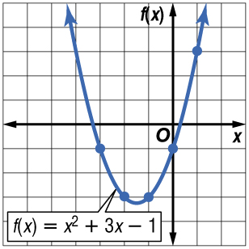
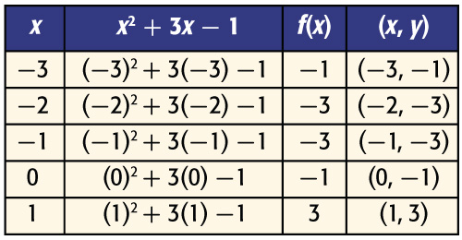
Example 1
Graph a Quadratic Function by Using a Table
Graph f(x) = x² + 3x – 1 by making a table of values.
Choose integer values for x and evaluate the function for each value. Graph the resulting coordinate pairs and connect the points with a smooth curve.
Answer:

Slide 6
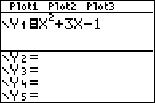
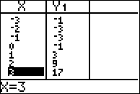
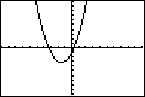
Step 1: Enter equation in Y=.
Step 2: 2nd/Graph
Step 3: Use Table of Values to graph parabola or use table of values to match graph to equation.
Step 3
Step 2
Step 1

Slide 7


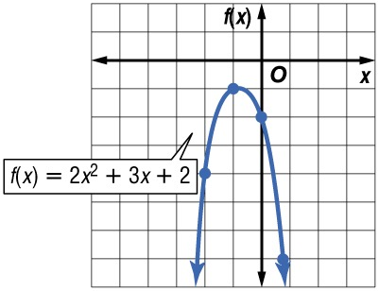
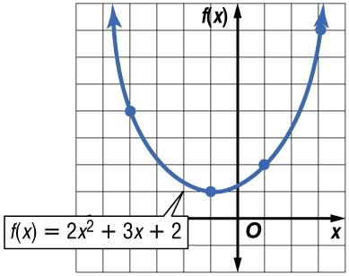
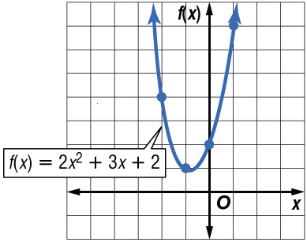
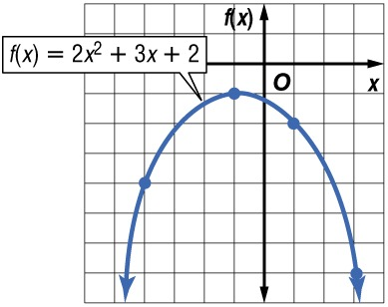
Example 1
Which graph is the graph of f(x) = 2x² + 3x + 2?
A. B.
C. D.
A
B
C
D

Slide 8
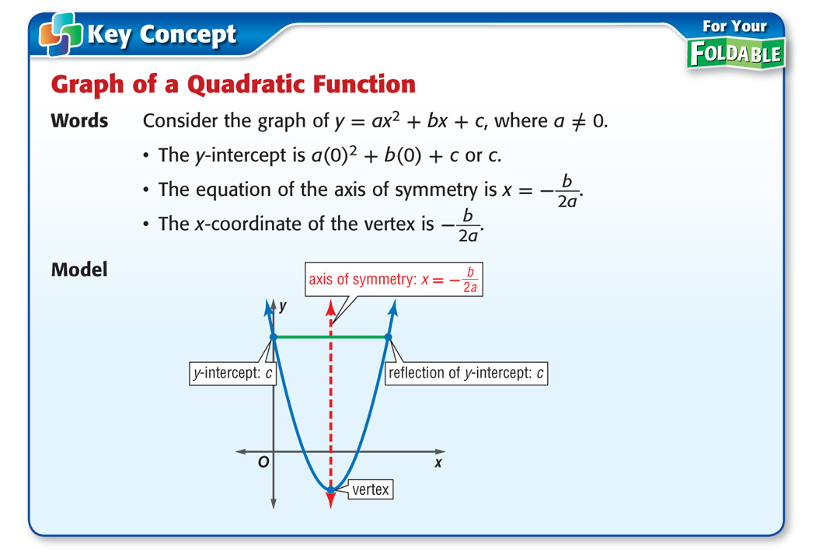
Concept

Slide 9
Example 2
Axis of Symmetry, y-intercept, and Vertex
A. Consider the quadratic function f(x) = 2 – 4x + x². Find the y-intercept, the equation of the axis of symmetry, and the x-coordinate of the vertex.
Begin by rearranging the terms of the function so that the quadratic term is first, the linear term is second and the constant term is last. Then identify a, b, and c.
f(x) = ax² + bx + c
a = 1, b = –4, c = 2
f(x) = 2 – 4x + x²
f(x) = 1x² – 4x + 2
The y-intercept is 2.

Slide 10
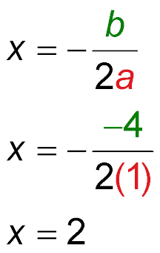
Example 2
Axis of Symmetry, y-intercept, and Vertex
Use a and b to find the equation of the axis of symmetry.
Equation of the axis of symmetry
a = 1, b = –4
x = 2 Simplify.
Answer: The y-intercept is 2. The equation of the axis
of symmetry is x = 2.Therefore, the
x-coordinate of the vertex is 2.

Slide 11
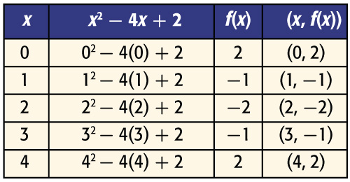
Example 2
Axis of Symmetry, y-intercept, and Vertex
B. Consider the quadratic function f(x) = 2 – 4x + x². Make a table of values that includes the vertex.
Choose some values for x that are less than 2 and some that are greater than 2. This ensures that points on each side of the axis of symmetry are graphed.
Answer:
Vertex

Slide 12
Example 2
Axis of Symmetry, y-intercept, and Vertex
C. Consider the quadratic function f(x) = 2 – 4x + x². Use the information from parts A and B to graph the function.
Graph the vertex and y-intercept.
Then graph the points from your table, connecting them with a smooth curve.
As a check, draw the axis of symmetry, x = 2, as a dashed line.
The graph of the function should be symmetrical about this line.

Slide 13
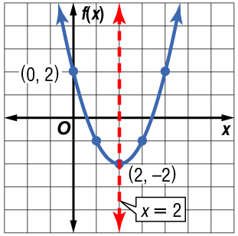
Example 2
Axis of Symmetry, y-intercept, and Vertex
Answer:

Slide 14
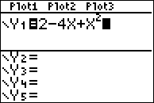
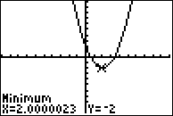
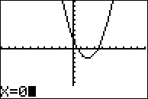
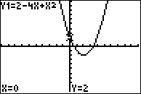
On calculator:
  Step 1: Enter equation in Y1=
  Step 2: Graph equation
    Need to see max/min & y-intercept. Change window, if necessary.
  Step 3: Find Vertex
    Vertex is Max or Min point - Refer to ISN page 21-22 for instructions
  Step 4: Axis of Symmetry
    Axis of symmetry is x = c, where c is the x value of your vertex.
  Step 5: Y-intercept
    2nd/Trace/1:value
    Enter X=0. This will bring up the point (0, y) for your y-intercept
Step 1
Step 2/3
Step 5

Slide 15
Example 2
A. Consider the quadratic function f(x) = 3 – 6x + x². Find the y-intercept, the equation of the axis of symmetry, and the x-coordinate of the vertex.
A. y-intercept = 3, axis of symmetry: x = –3,
x-coordinate = –3
B. y-intercept = –3, axis of symmetry: x = 3,
x-coordinate = 3
C. y-intercept = 3, axis of symmetry: x = 3,
x-coordinate = 3
D. y-intercept = –3, axis of symmetry: x = –3,
x-coordinate = –3
A
B
C
D

Slide 16




Example 2
B. Consider the quadratic function f(x) = 3 – 6x + x². Make a table of values that includes the vertex.
A.
B.
C.
D.
A
B
C
D

Slide 17
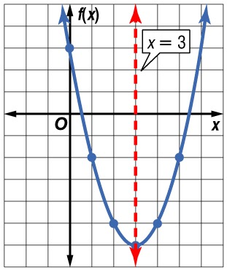
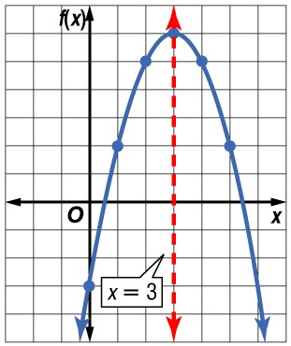
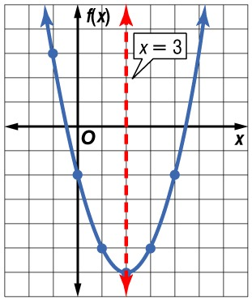
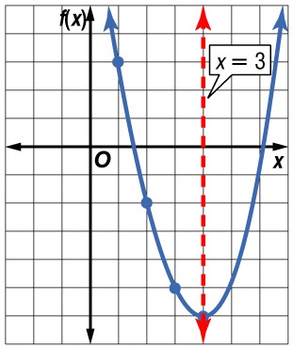
Example 2
C. Consider the quadratic function f(x) = 3 – 6x + x².
Use the information from parts A and B to graph the function.
A. B.
C. D.
A
B
C
D

Slide 18
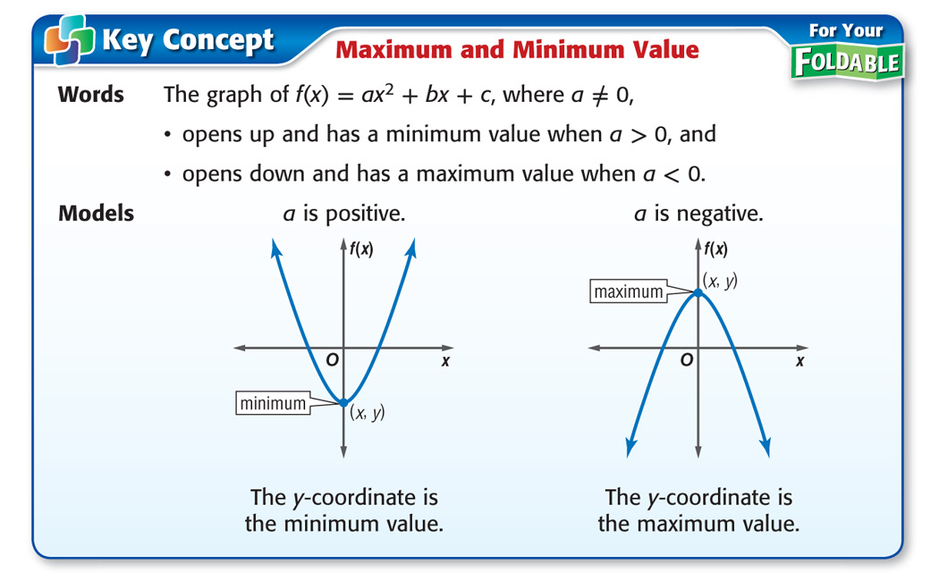
Concept

Slide 19
Example 3
Maximum or Minimum Values
A. Consider the function f(x) = –x² + 2x + 3. Determine whether the function has a maximum or a minimum value.
For this function, a = –1, b = 2, and c = 3.
Answer: Since a < 0, the graph opens down and the function has a maximum value.

Slide 20
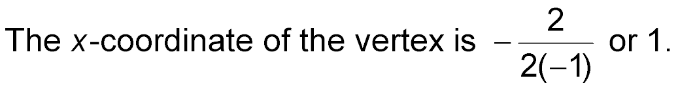
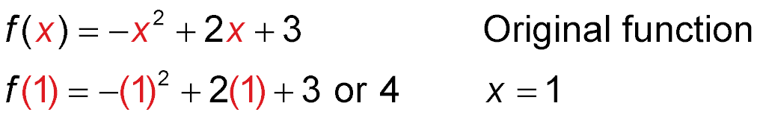
Example 3
Maximum or Minimum Values
B. Consider the function f(x) = –x² + 2x + 3. State the maximum or minimum value of the function.
The maximum value of this function is the y-coordinate of the vertex.
Find the y-coordinate of the vertex by evaluating the function for x = 1.
Answer: The maximum value of the function is 4.

Slide 21
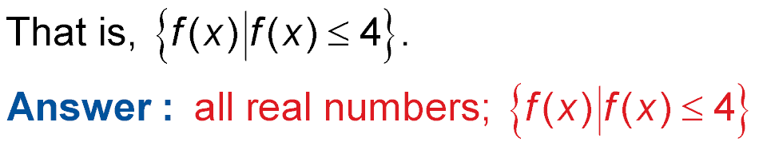
Example 3
Maximum or Minimum Values
C. Consider the function f(x) = –x² + 2x + 3. State the domain and range of the function.
The domain is all real numbers.
The range is all real numbers less than or equal to the maximum value.

Slide 22
Example 3
A. Consider the function f(x) = x² + 4x – 1. Determine whether the function has a maximum or a minimum value.
A. maximum
B. minimum
C. both
D. none
A
B
C
D

Slide 23
Example 3
B. Consider the function f(x) = x² + 4x – 1. What is the maximum or minimum value of the function?
A. –5
B. –1
C. 5
D. none
A
B
C
D

Slide 24
Example 3
C. Consider the function f(x) = x² + 4x – 1. What are the domain and range of the function?
A. D = {all real numbers};
R = {f(x) | f(x) ≥ –5}
B. D = {all real numbers};
R = {f(x) | f(x) ≤ –5}
C. D = {x ≥ –5};
R = {all real numbers}
D. D = {x ≤ –5};
R = {all real numbers}
A
B
C
D

Slide 25
Example 4
Quadratic Equations in the Real World
A. ECONOMICS A souvenir shop sells about
200 coffee mugs each month for $6 each. The shop owner estimates that for each $0.50 increase in the price, he will sell about 10 fewer coffee mugs per month. How much should the owner charge for each mug in order to maximize the monthly income from their sales?
Words Income equals number of mugs times price.
Variable Let x = the number of $0.50 price increases. Let I(x) equal the income as a function of x.

Slide 26
Example 4
Quadratic Equations in the Real World
number of mugs
price per mug.
Income
is
times
Equation I(x) = (200 – 10x) ● (6 + 0.50x)
I(x) = (200 – 10x) ● (6 + 0.50x)
= 200(6) + 200(0.50x) – 10x(6) – 10x(0.50x)
= 1200 + 100x – 60x – 5x² Multiply.
= 1200 + 40x – 5x² Simplify.
= –5x² + 40x + 1200 Write in
ax² + bx + c form.

Slide 27
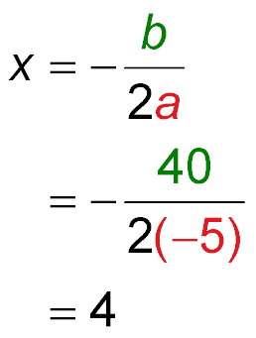
Example 4
Quadratic Equations in the Real World
I(x) is a quadratic function with a = –5, b = 40, and
c = 1200. Since a < 0, the function has a maximum value at the vertex of the graph. Use the formula to find the x-coordinate of the vertex.
Formula for the
x-coordinate of the vertex
a = –5, b = 40
Simplify.

Slide 28
Example 4
Quadratic Equations in the Real World
This means that the shop should make 4 price increases
of $0.50 to maximize their income.
Answer: The mug price should be $6 + $0.50(4) or $8.

Slide 29
Example 4
Quadratic Equations in the Real World
B. ECONOMICS A souvenir shop sells about
200 coffee mugs each month for $6 each. The shop owner estimates that for each $0.50 increase in the price, he will sell about 10 fewer coffee mugs per month. What is the maximum monthly income the owner can expect to make from these items?
To determine the maximum income, find the maximum
value of the function by evaluating I(x) for x = 4.
I(x) = –5x² + 40x + 1200 Income function
= –5(4)² + 40(4) + 1200 x = 4
= $1280 Use a calculator.
Answer: Thus, the maximum income is $1280.

Slide 30
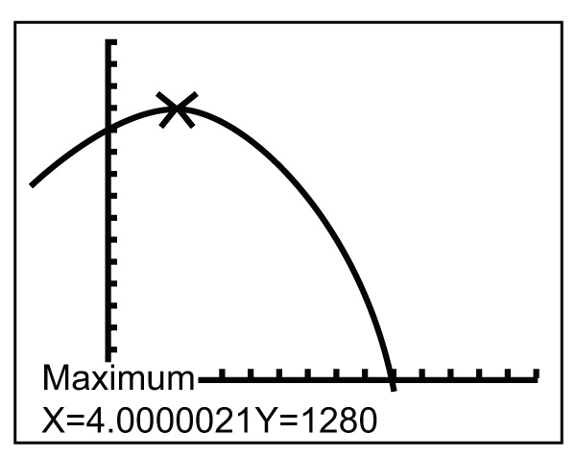
Example 4
Quadratic Equations in the Real World
Check Graph this function on a graphing calculator, and use the CALC menu to confirm this solution.
Keystrokes:
2nd
ENTER
ENTER
ENTER
[CALC] 4 0 10
At the bottom of the display are the coordinates of the maximum point on the graph of
y = –5x² + 40x + 1200. The
y-value of these coordinates is the maximum value of the function, or 1280.

Slide 31
Example 4
A. ECONOMICS A sports team sells about
100 coupon books for $30 each during their annual fundraiser. They estimate that for each $0.50 decrease in the price, they will sell about 10 more coupon books. How much should they charge for each book in order to maximize the income from their sales?
A
B
C
D
A. $29.50
B. $20.00
C. $17.50
D. $15.00

Slide 32
Example 4
B. ECONOMICS A sports team sells about
100 coupon books for $30 each during their annual fundraiser. They estimate that for each $0.50 decrease in the price, they will sell about 10 more coupon books. What is the maximum income the team can expect to make from these items?
A. $3123.75
B. $5843.75
C. $6125.00
D. $12,250.00
A
B
C
D

Slide 33
End of the Lesson

